Slide 1
IDS Alert System
Ryan Becker

Slide 2
01
The Question

Slide 3
How can we build a wireless IDS to send real time alerts with suricata and python?

Slide 4
Limitations with Question
Managed Switch
Virtual Switch
01
02
Key to Port Mirroring router traffic for Datalink IDS
Got Close but lacked visibility of any attacks
TCPDump
Mobile Texts
03
04
Challenges with TCPDump implementation with python, acts too passive from what I found
Some platforms are free, but seemed off with format of site. So resorted away from text alerts

Slide 5
Slightly new Question: Can I create an IDS behind an AP, where a user can connect their devices and get real time alerts via Discord of network activity, while they are away?

Slide 6
Potential Limitations
01
02
DDoS
ARP Attack
DDoS Delays alerts due to flooding via SYN or other packets. Therefore, does not correctly alert in real time.
Will not alert if there is an ARP MItM attack on the SETUP-#### SSID. This is due to suricata being specific to SuricataAP.

Slide 7
02
Topology

Slide 8
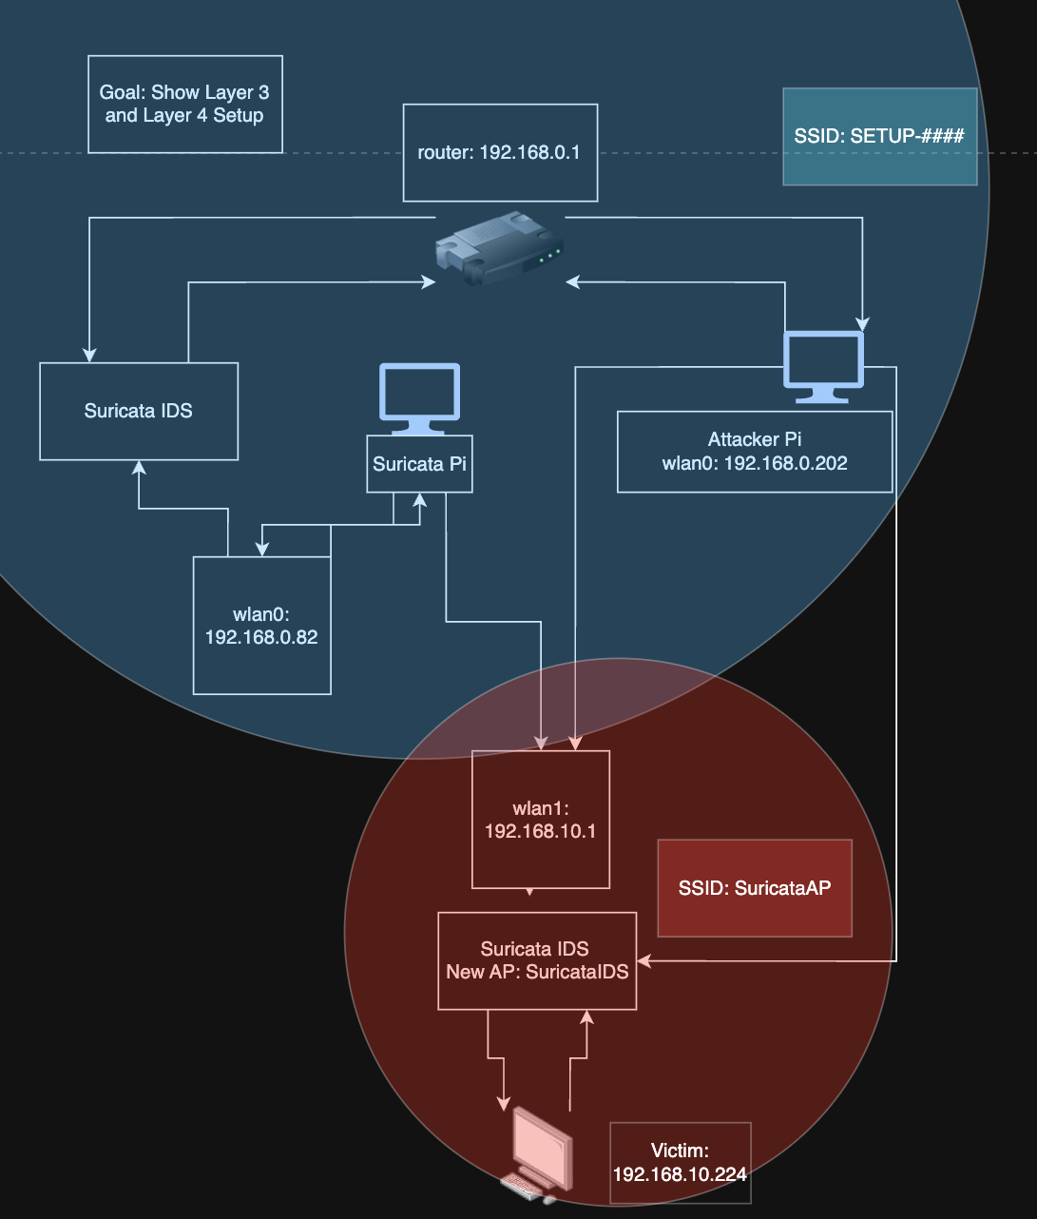
Layer 3 and 4 IDS Setup

Slide 9
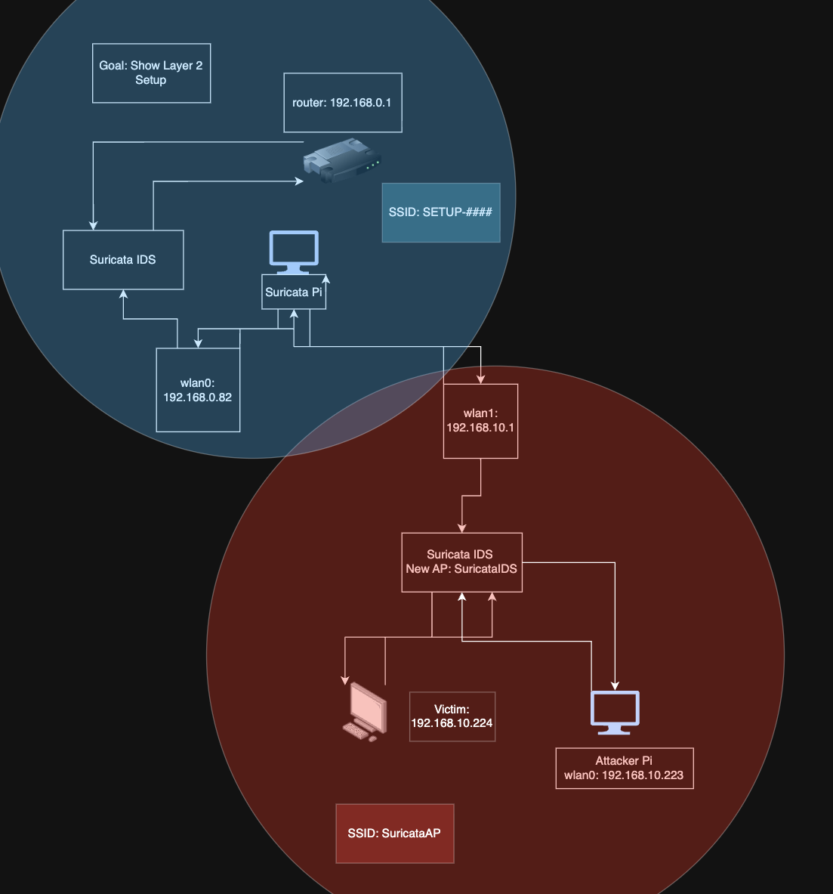
Layer 2 IDS Setup

Slide 10
03
Suricata PI Setup

Slide 11
Suricata Process
Network Manager Configuration
Suricata Configuration
Step 1
Step 2
Step 3
Step 4
IPTables Configuration
Discord Alert Python File

Slide 12
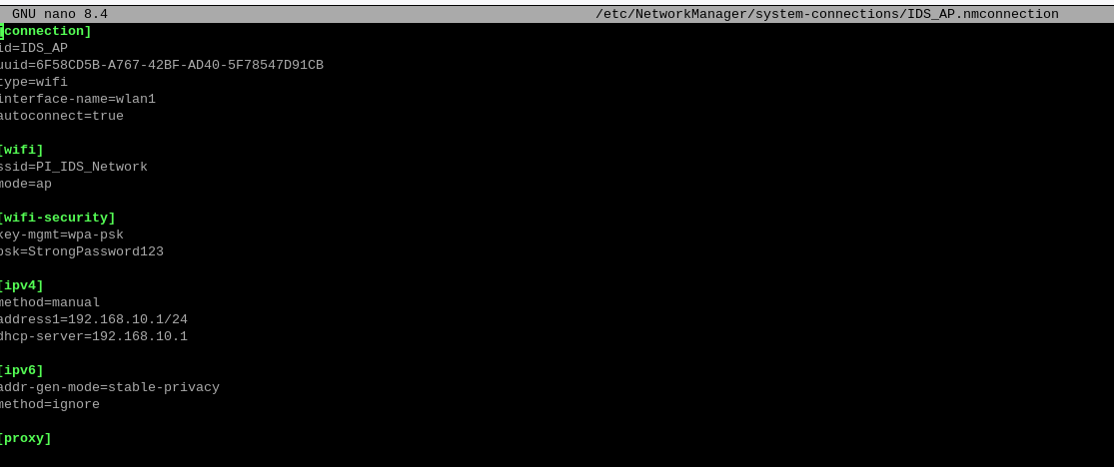
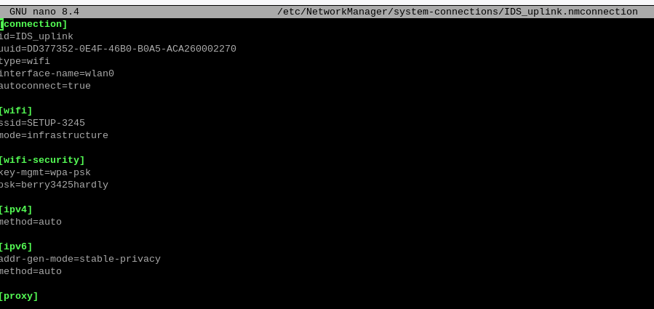
Step 1

Slide 13
Step 1

Slide 14
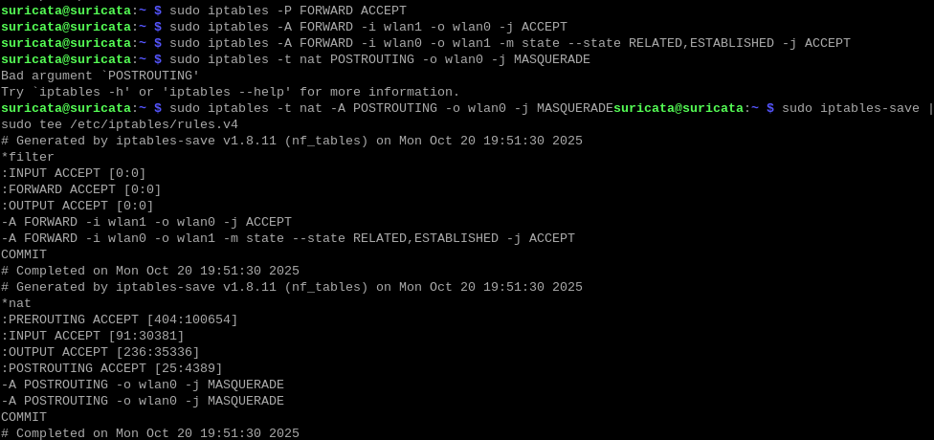
Step 2

Slide 15
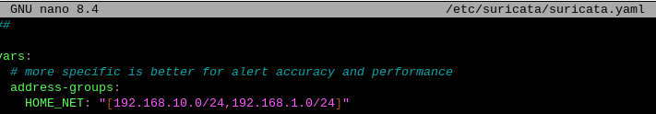
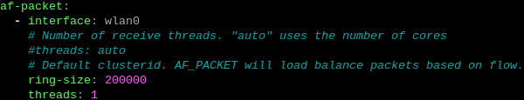
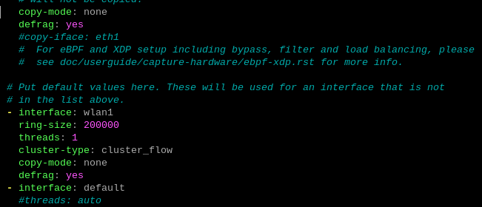
Step 3

Slide 16
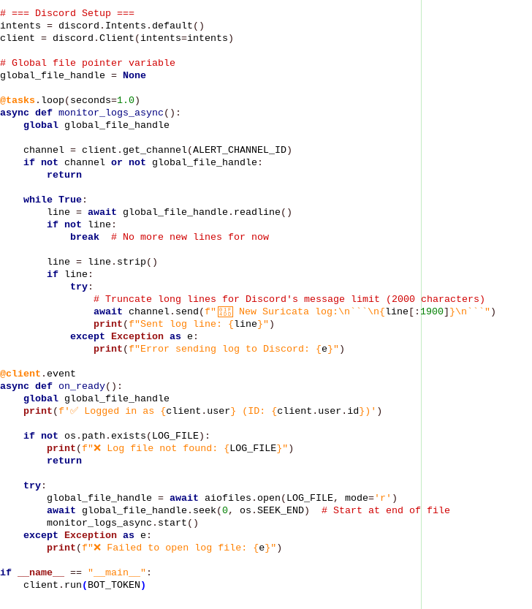
Step 4

Slide 17

Step 4

Slide 18
04
Victim Device Setup

Slide 19
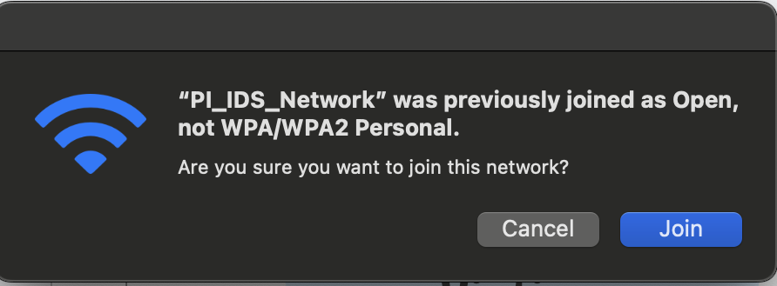
Step 4

Slide 20
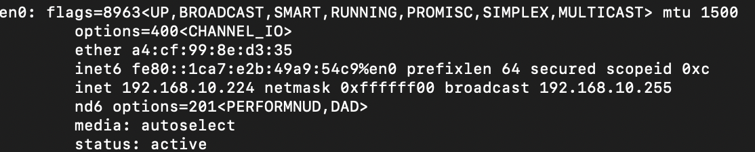
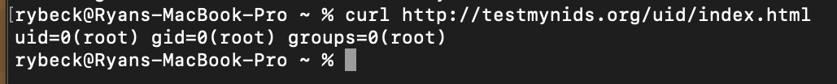
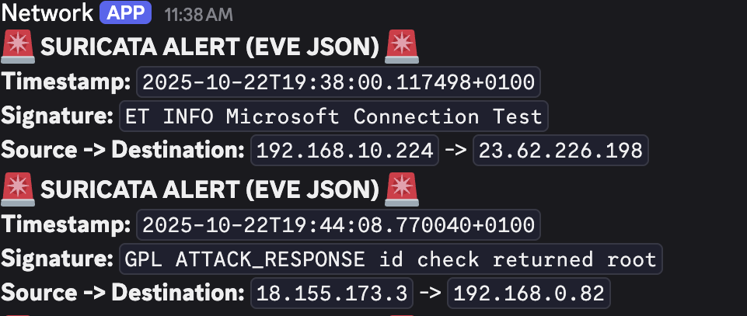
Step 4

Slide 21
05
Attacker PI Setup

Slide 22
Attacker Pi Process
Use Nmap to map the network (wlan1)
DDoS attack against wlan0
Step 1
Step 2
Step 3
Step 4
Use Nmap to map the network (wlan0)
Inspect Logs

Slide 23
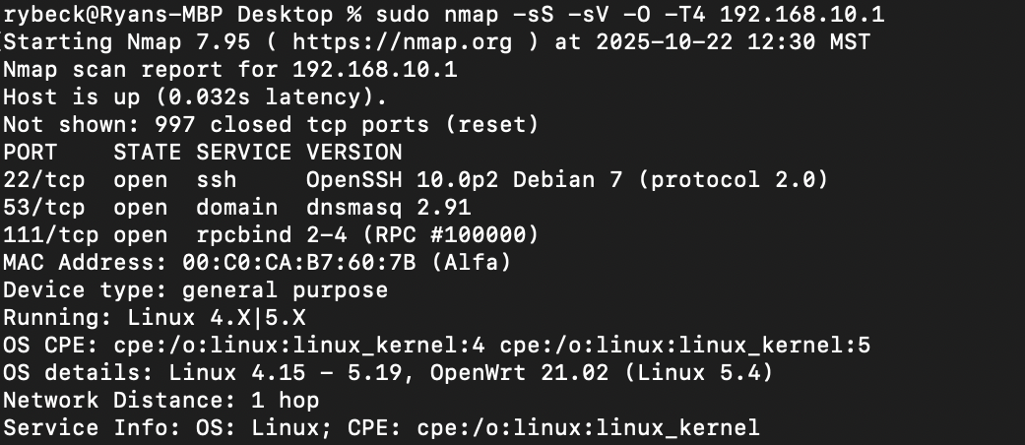
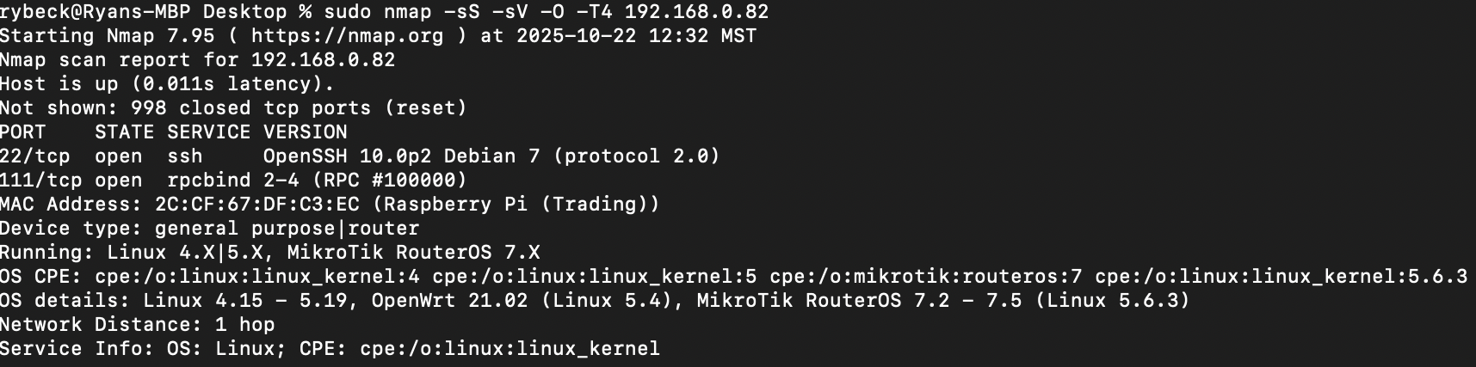
Step 1

Slide 24
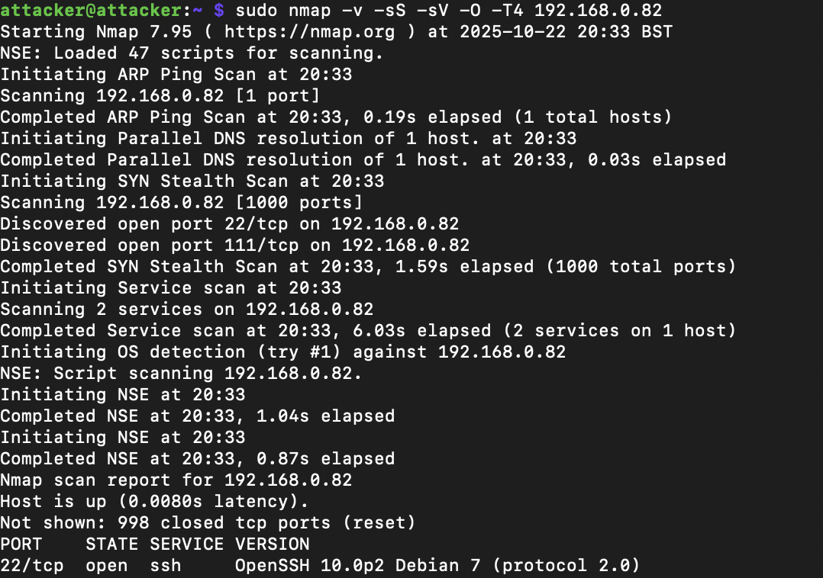
Step 2

Slide 25
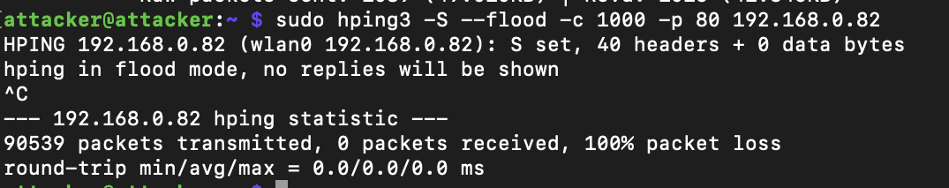
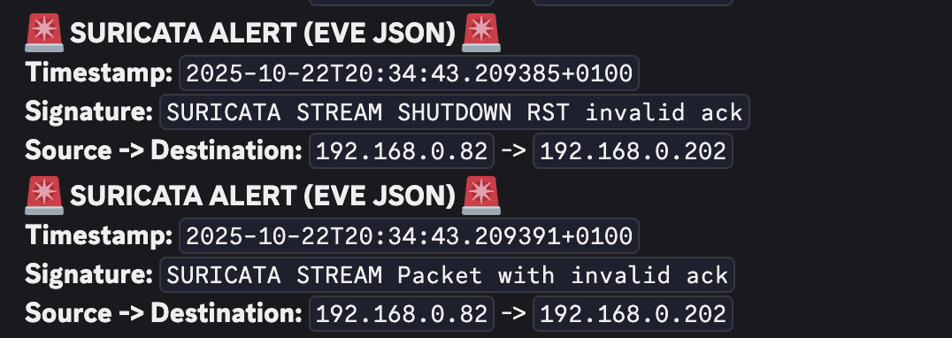
Step 3

Slide 26
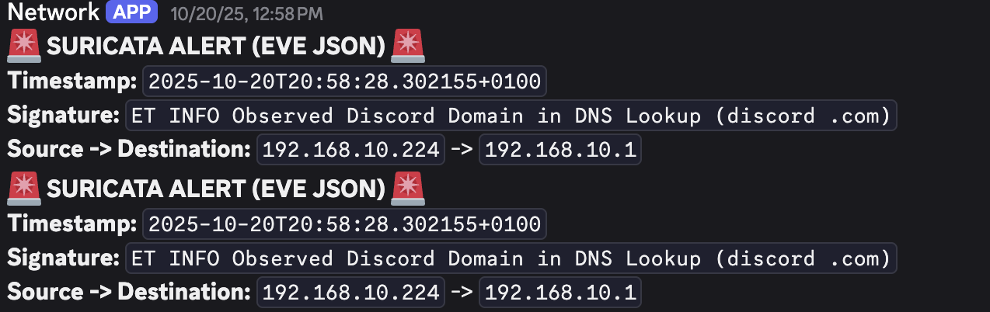
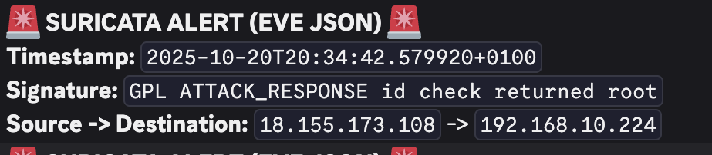
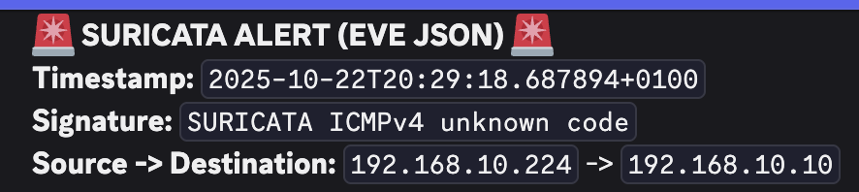
Step 4

Slide 27
Thank You!

Slide 28
Questions?

